Slide 1
Effective Practices: Retention plans
Institute of American Indian Arts and
Ilisagvik College
Chelsi Danner, Diane Reyna, Jeminie Shell
Presented to AIHEC 40th Anniversary Conference
August 9, 2013

Slide 2
OVERVIEW
Group exercise
Introduction/history of grant collaboration
Definition and purpose of Retention Plans
The Logic Model
IAIA and Ilisagvik plans
Key outcomes
Lessons learned and recommendations

Slide 3
WALMART COLLABORATIVE
THE IAIA-ILISAGVIK STORY
Timeline: November 2011- present
Grant team members – heavy turnover
Site visits
Identifying needs and interests
Narrowing focus – we can’t do everything at once
Finalized goals by end of December 2011

Slide 4
ILISAGVIK’S FINAL GOALS
Develop Strategic Retention Plan
using logic model that the Walmart TCU community was using
ensuring measurable outcomes and assessment
Institutionalize the plan (sustainability)
Improve Learning Resource Center (LRC)
Improve Orientation program and delivery
Develop culturally relevant First Year Seminar

Slide 5
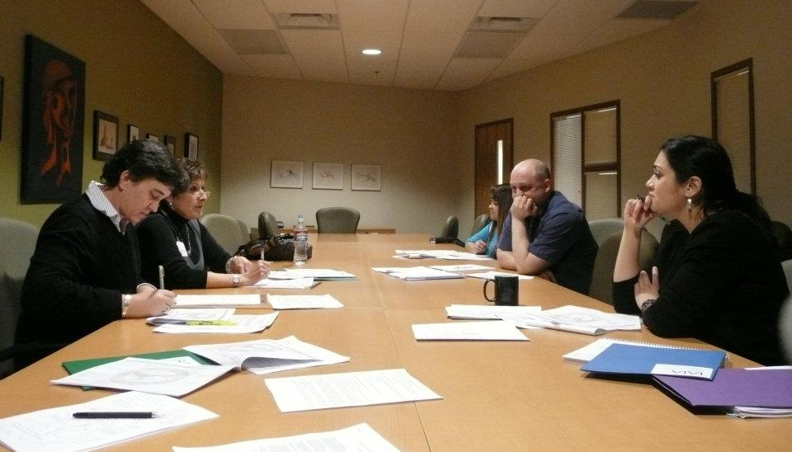
RETENTION PLANS – PURPOSE
Retention Plans are (should be) a set of initiatives or programs strategically chosen to address an institution’s retention challenges.

Slide 6
RETENTION PLANS – PURPOSE and KEY COMPONENTS
Initiatives chosen should be based on data to better target institution’s challenge areas:
Persistence (term-to-term)
Progression (successful persistence/course completion)
Retention (fall-to-fall)
Completion (defined by institution)

Slide 7
IAIA RETENTION PLAN

Slide 8
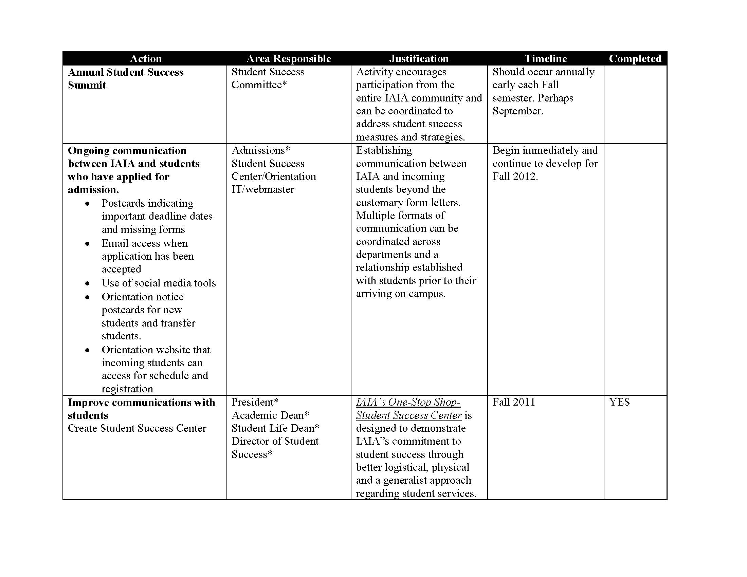
IAIA RETENTION PLAN

Slide 9
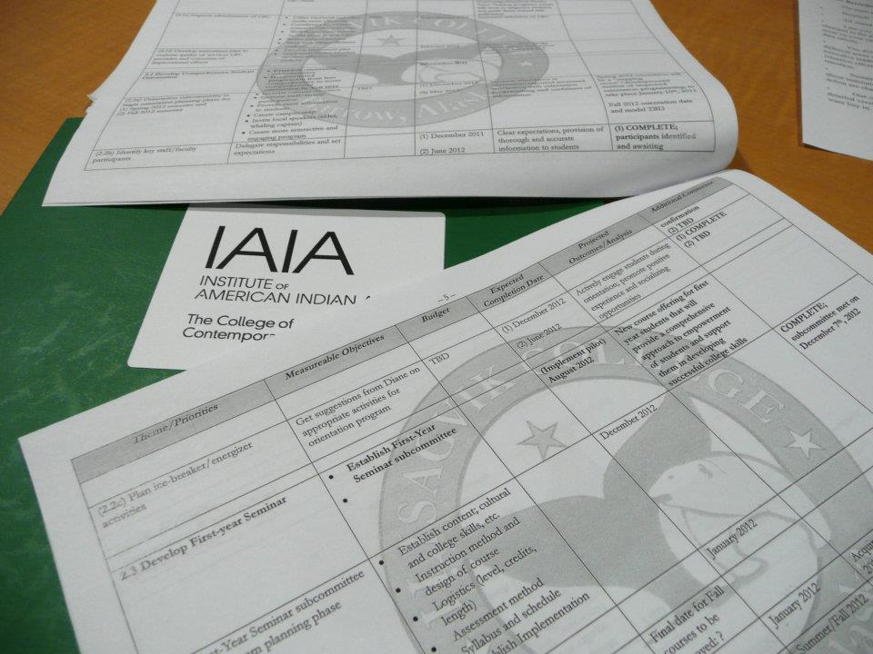
LOGIC MODEL
A Logic Model is one of a variety of ways to format a Retention Plan, and it is the model that was adopted by the TCU group under the Walmart grant

Slide 10
LOGIC MODEL
Goal 1: [IDENTIFY A RETENTION GOAL, IDEALLY BASED ON DATA AND TARGETING PROBLEM AREAS]`
1. Objective /and Description (who, what, how, when) | 2. Outcomes or expected Results | 3. Measurement, documentation or evaluation processes | 4. Findings (Actual results) | 5. Action or Recommendation
Initiative/Program How implemented When implemented Who is responsible | How do you expect this initiative/ program to impact your goal | S. Specific M. Measurable A. Attainable R. Relevant T. Time-bound | Data results and analysis | Recommendations based on data analysis

Slide 11
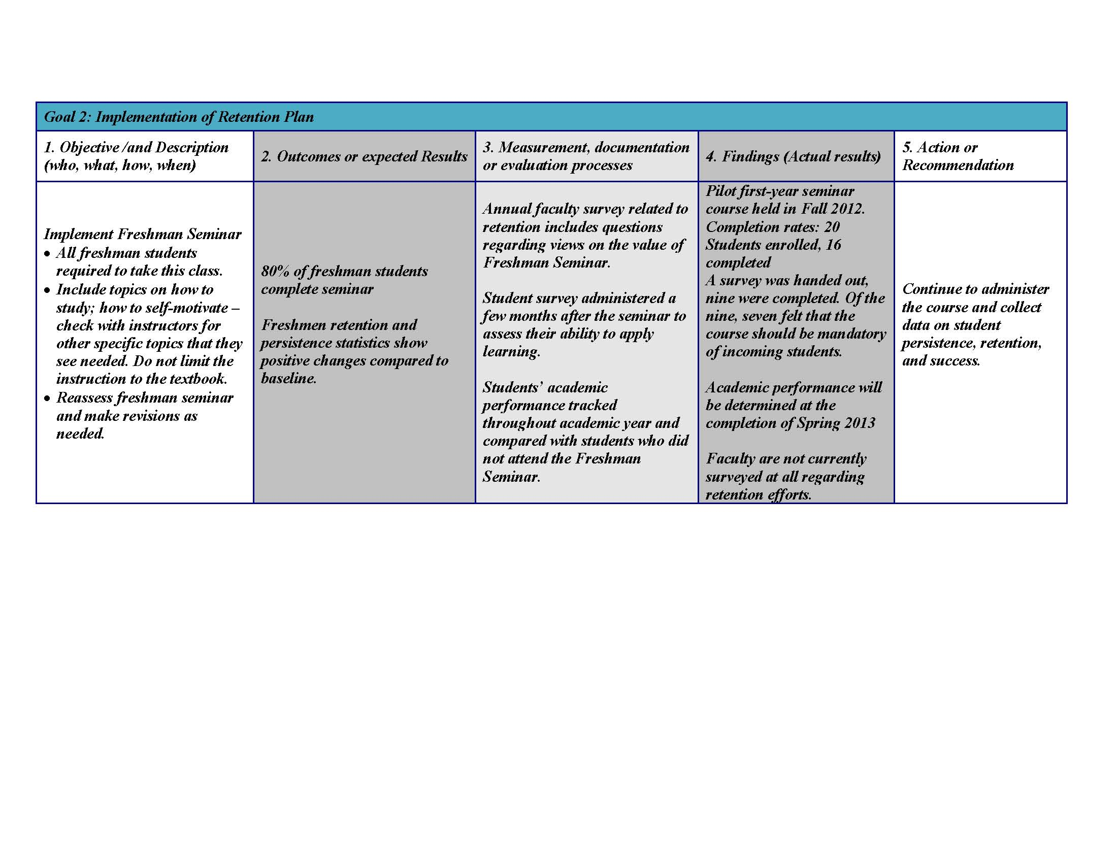
ILISAGVIK RETENTION PLAN

Slide 12
ILISAGVIK RETENTION PLAN

Slide 13
KEY OUTCOMES
All Ilisagvik data collected for Retention Plan has been analyzed and reported and/or acted upon
First Year Seminar and other programs are being redesigned based on assessment of collected data
Data from Retention Plan, and Plan itself, are incorporated into annual Institutional Research report
Funding made available for implementation of programs in the retention plan to support these initiatives
Structure for identifying, implementing, and assessing programs.

Slide 14
LESSONS LEARNED and RECOMMENDATIONS
CHALLENGE
Without data-driven decisions about which initiatives to pursue and measurable outcomes for assessment, it is unclear whether initiatives are having the intended impacts.

Slide 15
LESSONS LEARNED and RECOMMENDATIONS
RECOMMENDATIONS
Identify areas or departments that are collecting the data you need
Work with Institutional Researcher if possible
Identify high impact initiatives/best practices
Choose existing initiatives to begin tracking and assessing/improving

Slide 16
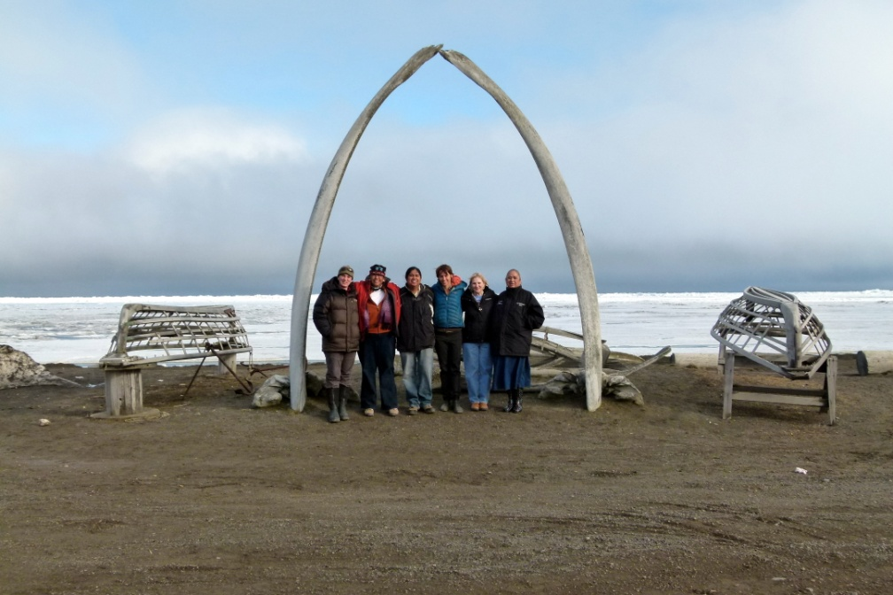
LESSONS LEARNED and RECOMMENDATIONS
CHALLENGE
Turnover and subsequent loss of ‘institutional memory’ is something that happens all the time, at all levels.

Slide 17
LESSONS LEARNED and RECOMMENDATIONS
RECOMMENDATIONS
Work to ensure buy-in and support at multiple administrative levels
Embed the work in a Retention Committee to help improve sustainability
Embed the plan/connect it to the institution’s Strategic Plan to create
Mechanism for sustainability
Mechanism for accountability

Slide 18
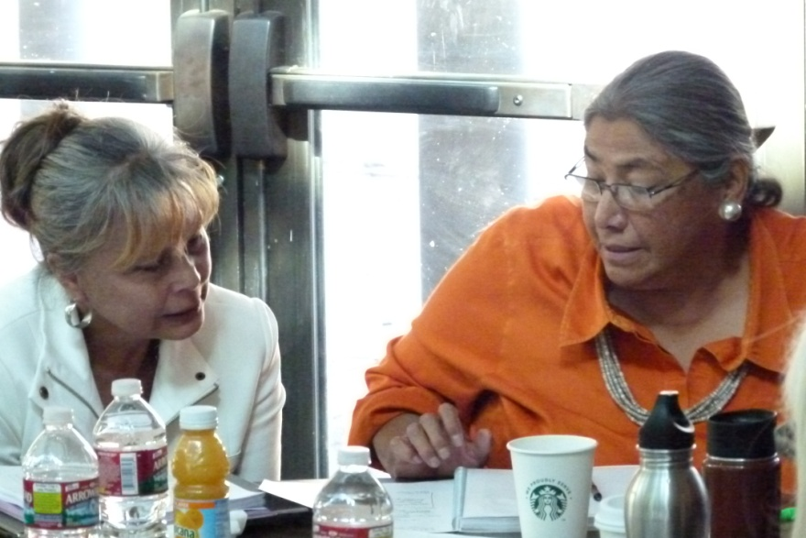
LESSONS LEARNED and RECOMMENDATIONS
CHALLENGE
‘Closing the circle’ or finishing the assessment process can often get lost in the shuffle, especially if you haven’t clearly defined why you are gathering the data or what you will do with it.

Slide 19
LESSONS LEARNED and RECOMMENDATIONS
RECOMMENDATIONS
Include your Institutional Researcher on your Retention Committee
Alternatively, create an assessment team within your Retention Committee
Embed the plan/connect it to the institution’s Strategic Plan to create
Mechanism for sustainability
Mechanism for accountability

Slide 20
QUESTIONS?

